Slide 1
PRESENTATION
BY
TEAM DATA CHAMPS

Slide 2
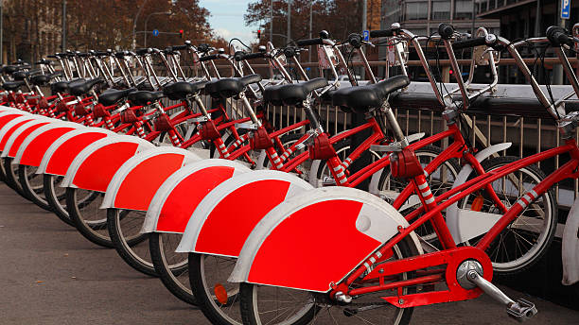
Prediction of bike count demand in Bike Sharing system
Leveraging Weather Data

Slide 3



Bike sharing System
A bike-sharing system is a public transportation service that provides access to bicycles for short-term use, typically on a pay-as-you-go
Revenue is generated from user fees, and the companies covers operational costs, maintenance, and expansion costs

Slide 4
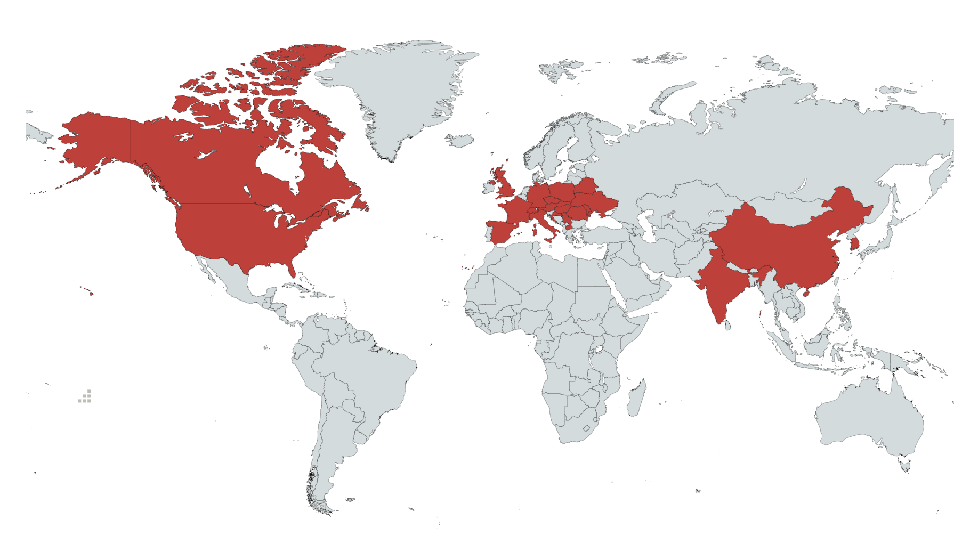
Market analysis
Mar
$12.68 billions
$340 millions
$8.44 billions
$314 millions
2023
2027
2023
2027

Slide 5
Data Source
Source: SEOUL METROPOLITAN BIKE SHARING SYSTEM (south Korea)
It has a market share of 73 % in South Korea
Time span: November 2017 to December 2018
Docking stations: 145
Price per bike per hour:1000 KRW (7 USD)
Weather data: Temperature, dew, snow fall, rainfall, etc.
Instances: 365 days*24 hours->8760 rows
Operation cost and maintenance cost is 50% of revenue.

Slide 6
KPI
Forecast the demand of bike count
Risks
Weather risk and operation cost
Prepare a model to predict bike demand by leveraging weather data and classifying days into different types (e.g., holidays, weekends, working days). The objective is to enhance operational efficiency and resource allocation for the bike-sharing service and maximize the profit.
Problem
Statement

Slide 7
Evaluation
metrics
Profit Maximization: Assess the model's effectiveness in maximizing profit by finding the optimal balance between bike supply and demand, considering operational costs and ability to minimize operational costs by determining the optimal deployment of bikes to docking stations .

Slide 8
False positives are the instances where model under predict the bike count and we incur loss for not deploying the require number of bikes = (actual-predict)40,
False negatives are the instances where model over predict bike count and we incur loss for deploying more than required=(predict-actual)40
Here we assumed that the operations cost is 50% of total revenue so we are getting equal values for FP and FN.
As we are giving equal importance to both FN and FP we can consider F1 score as the best metrics along with that the model total profit should be maximum.
Evaluation
metrics
FP=profit(TP)-(actual-predict)40
FN=profit(TP)-(predict-actual)40

Slide 9




Data Science model
Data collection
Data pre-processing
Model fitting
Model evaluation

Slide 10
Source: Open data Seoul metropolitan bike sharing
Features
Date: year-month-day
Hour — Hour of the day
Temperature-Temperature in Celsius
Humidity — %
Windspeed — m/s
Visibility — 10m
Dew point temperature — Celsius
Solar radiation — MJ/m2
Rainfall — mm
Snowfall — cm
Seasons — Winter, Spring, Summer, Autumn
Holiday — Holiday/No holiday
Functional Day — No Func (Non-Functional Hours), Fun(Functional hours)
Target: Rented Bike count — Count of bikes rented at each hour.
Data collection

Slide 11
Source: Open data Seoul metropolitan bike sharing
Features: Created three new columns converting date -> month , day and year
Dropped -> Functional day column there is 0 bike count on nonfunctional day
Target:
Here we classified the target bike count values in to five categories
[0,250,500,1000,2000,4000]->
Bike count | Category
0-250 | Very low demand
250-500 | Low demand
500-1000 | Moderate demand
1000-2000 | High demand
2000-4000 | Very high demand
Data Pre-processing

Slide 12
Evaluation
metrics
Predicted
1₩ = 0.007 USD
Average bike count | 130 | 355 | 741 | 1390 | 2351
130 | ₩65,000.00 | -₩47,500.00 | -₩2,40,500.00 | -₩5,65,000.00 | -₩10,45,500.00
355 | -₩47,500.00 | ₩1,77,500.00 | -₩15,500.00 | -₩3,40,000.00 | -₩8,20,500.00
741 | -₩2,40,500.00 | -₩15,500.00 | ₩3,70,500.00 | ₩46,000.00 | -₩4,34,500.00
1390 | -₩5,65,000.00 | -₩3,40,000.00 | ₩46,000.00 | ₩6,95,000.00 | ₩2,14,500.00
2351 | -₩10,45,500.00 | -₩8,20,500.00 | -₩4,34,500.00 | ₩2,14,500.00 | ₩11,75,500.00
Actual

Slide 13
Data Preprocessing summary
Load the data
8760 Entries
Cleaning up Categorical Data
14 Columns
Filtering Attributes
Data
Target –Bike count
8465 Entries, 18 columns
Dropping rows which has bike count 0
Data Pre-processing

Slide 14
Train and test split ratio 70 : 30
Standardization of data
Balancing data using SMOTE
Model fitting
Model fitting

Slide 15
MODELS FOR CLASSIFICATION
SVC linear
KNN classifier
Decision tree
MLP classifier
Random forest
Ada boost classifier
Hyper parameter tuning for Ada boost classifier
Model fitting

Slide 16
Model Evaluation
Description | f1-score | Total_annual_profit | Profit in USD
SVC SMOTE | 0.97965626 | ₩89,59,36,500.00 | $62,71,555.50
KNN SMOTE | 0.7456345 | ₩69,58,21,500.00 | $48,70,750.50
RandomForestClassifier SMOTE | 0.99960634 | ₩91,01,75,500.00 | $63,71,228.50
Dtree SMOTE | 1 | ₩91,05,61,500.00 | $63,73,930.50
ANN SMOTE | 0.96015574 | ₩87,30,34,000.00 | $61,11,238.00
aboost SMOTE | 0.47024591 | ₩47,29,69,500.00 | $33,10,786.50
gboost SMOTE | 1 | ₩91,05,61,500.00 | $63,73,930.50
Evaluation
Decision Tree,
Gradient boost models

Slide 17

Previous Works
'Using data mining techniques for bike sharing demand prediction in metropolitan city
'A rule-based model for Seoul Bike sharing demand prediction using weather data
Our model is different…
We created a classification model for the case whereas previous works involves regression.
By converting the business scenario to classification, we have an extra edge on metrics to evaluate the model.
Our evaluation metrics is a highest Annual profit, particular instances the model may be in accurate but over all for a year we get the maximum profit.
Previous Works

Slide 18

Here The data set consist of only the weather data ( weather risk) ,we can add some other features like, geographical details, demographic features to predict bike count demand
For evaluation we considered the price and cost as per 2018 stats data, it should be revised as per the latest price details for max performance of a model.
We cannot use this model for different locations( in different cities) in some cities there may be swift change in weather forecast, so additional features are required for demand forecast.
Future Scope

Slide 19

BY
Team
Data Champs

